Slide 1



Data science project HOUSE PRICE PREDICTION
Submitted by:
Atul Mahajan

Slide 2
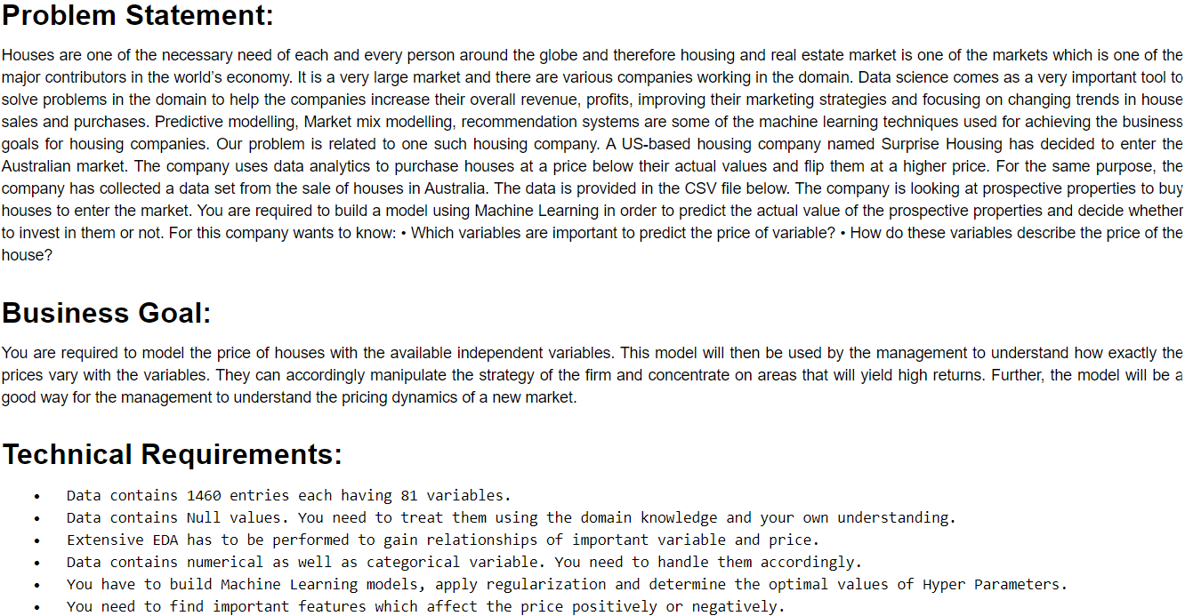
To predict Target Variable Sales Price based on 79 Features using Regression

Slide 3
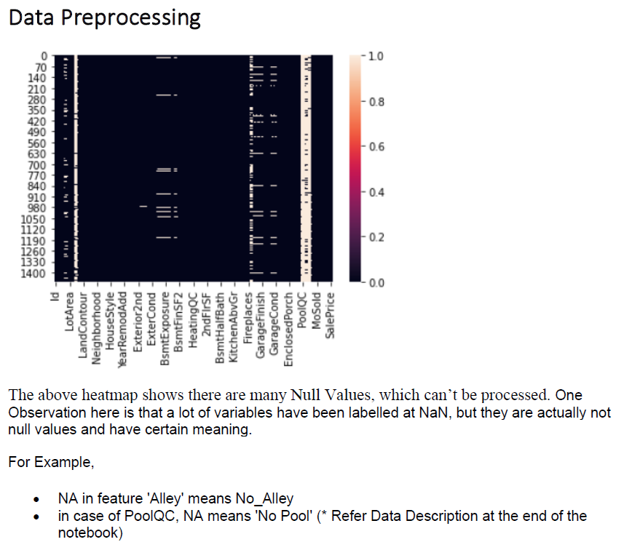
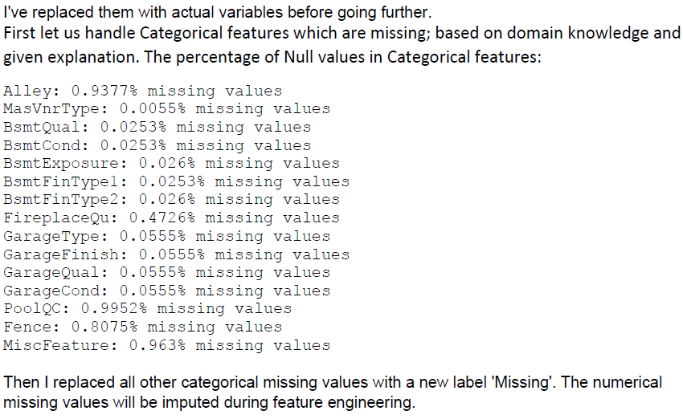
EDA Steps & Visualizations

Slide 4
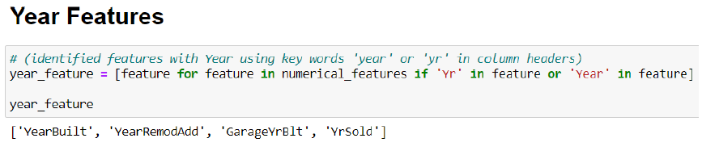
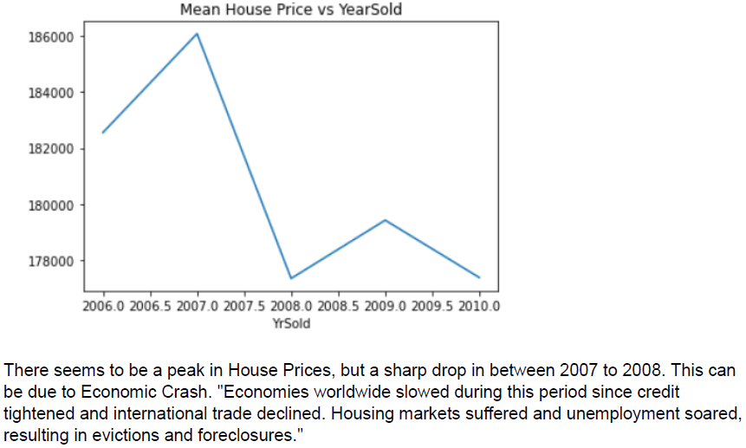
Classifying Features - Numerical
Identified all numerical features.
Out of 79, there were 37 numerical features
First Found out Temporal values (Year Features)

Slide 5
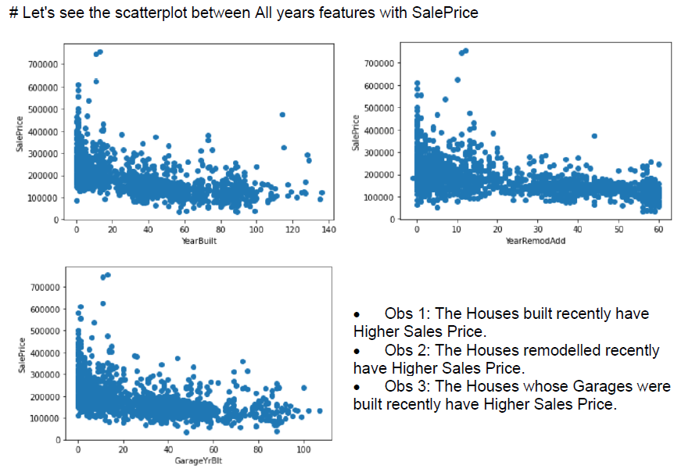
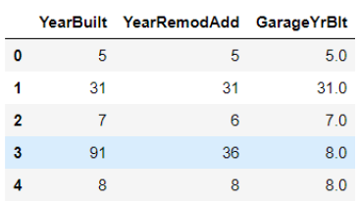
Scatterplots of Year Features vs Sales Price
Above features were created by finding difference from Year of Sale

Slide 6
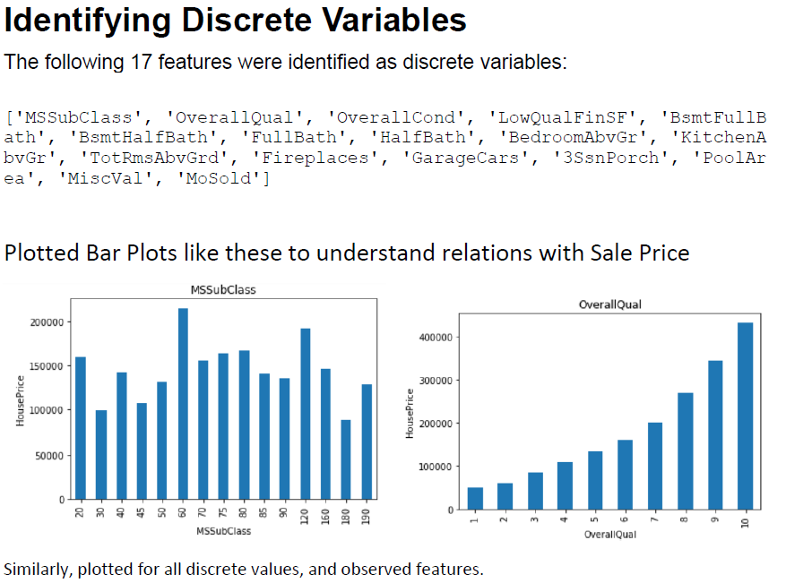
Out of 37 Numerical Features, identified 17 discrete features.

Slide 7
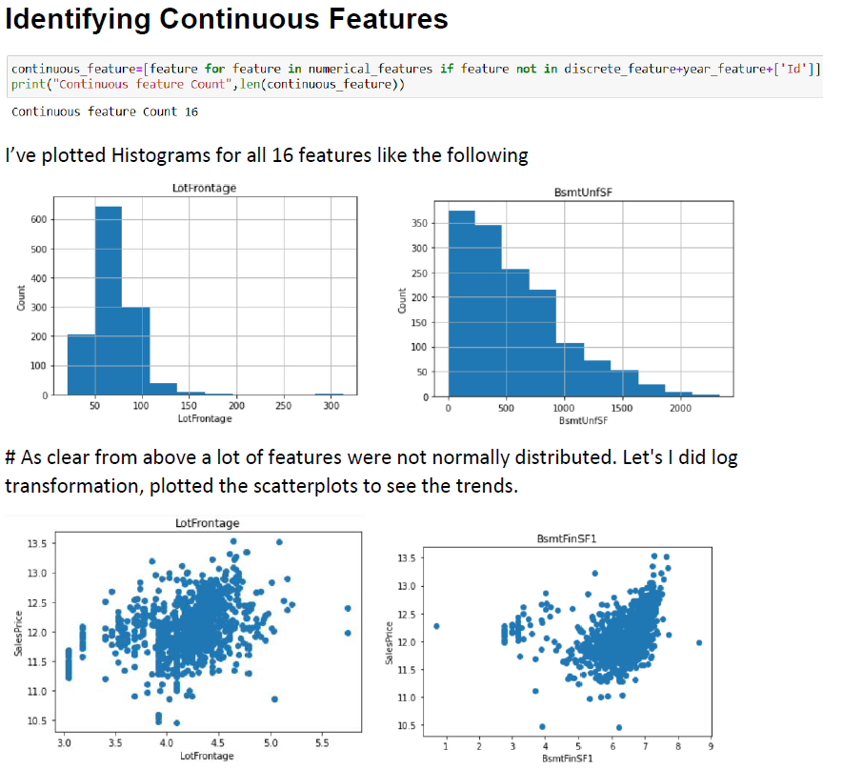
16 Continuous features out of 37 numerical features

Slide 8
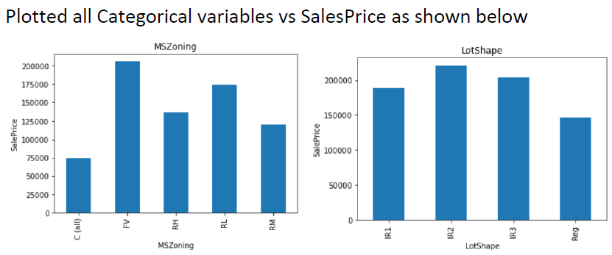
Categorical Features
Total 43 categorical Features were identified.

Slide 9
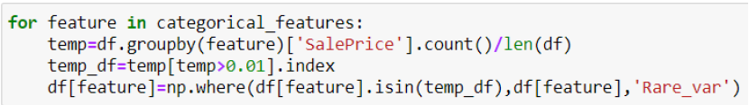
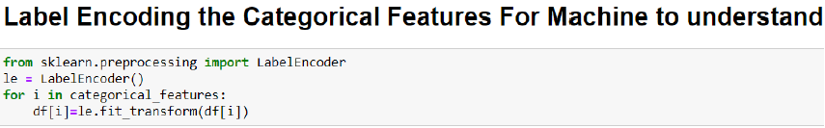
Feature Engineering Steps
Replaced categories less than 1% of total length
Training Data – 80%
Test Data – 20%
Before treating skewness with log1p transformation, divided data into train and test data, to avoid data leakage.

Slide 10
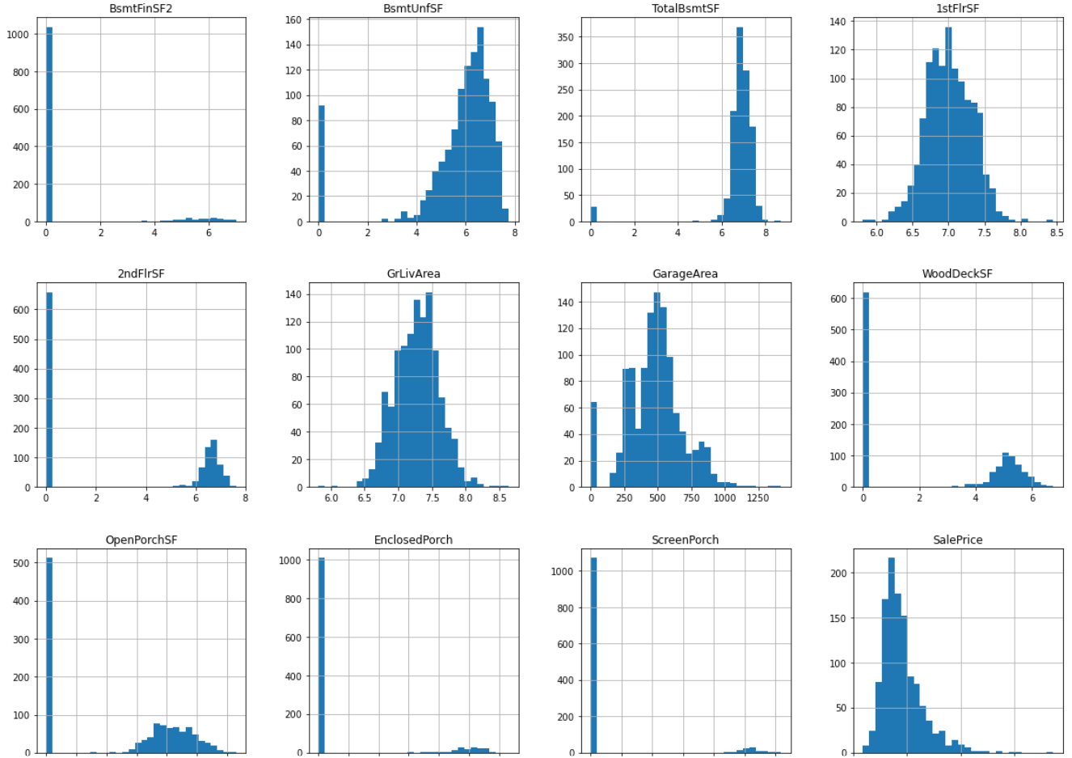
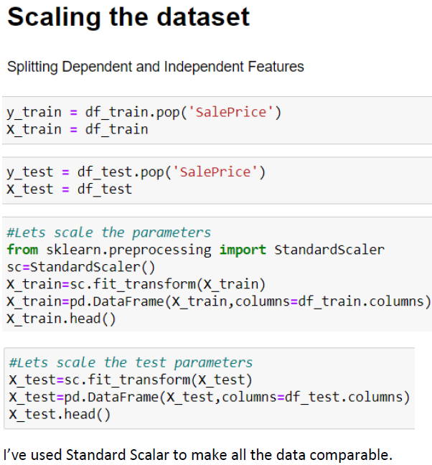
Examples of Distributions after Skewness Treatment
Standard Scalar

Slide 11
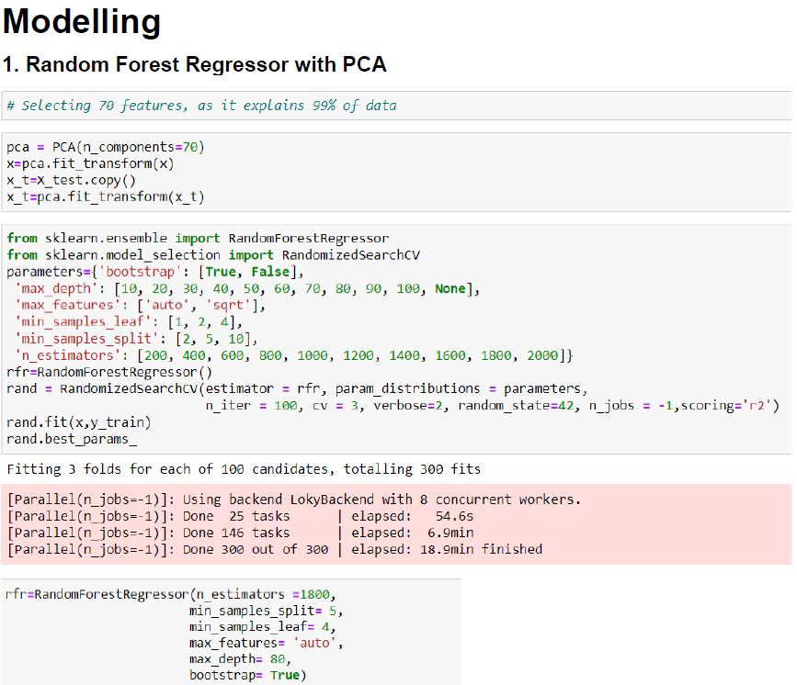
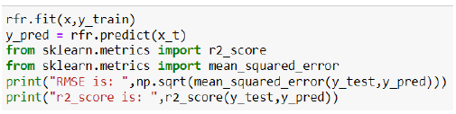

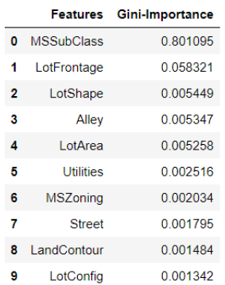
Models :1. Random Forest Regressor 2. XGBoost 3. Lasso Regressor 4. Ridge Regressor
Top 10 features based on Random Forest Regression

Slide 12
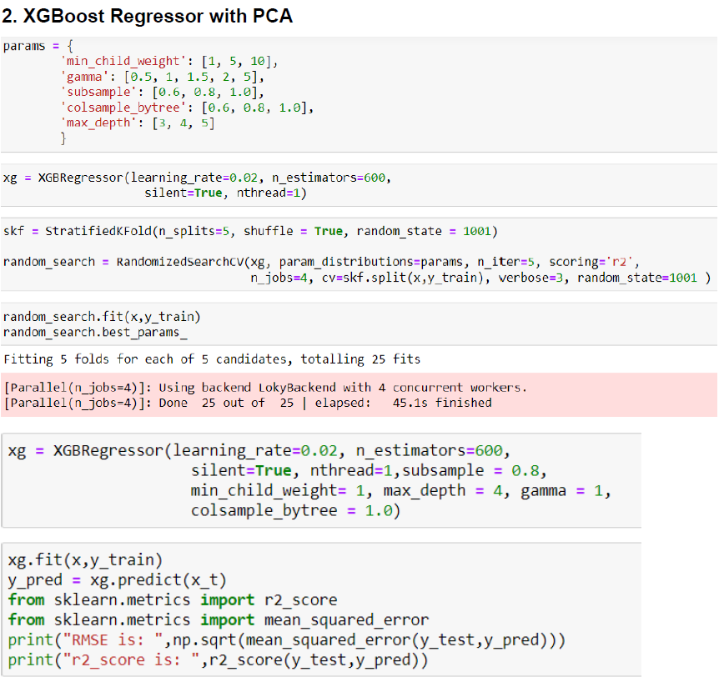
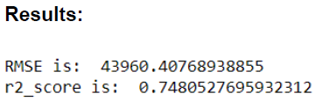
The score was way less than Random Forest, so I’ve rejected this model. Then I checked with the following models

Slide 13

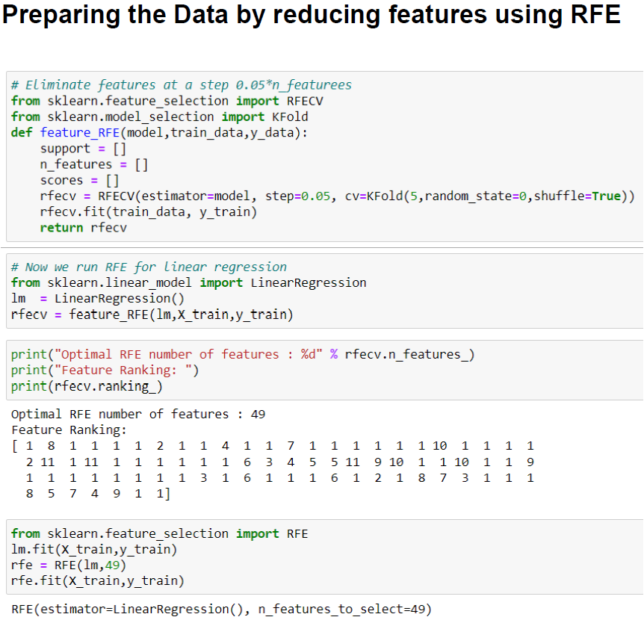
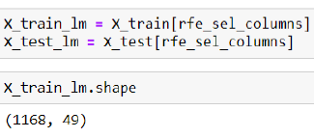
Feature ranking with RFE (recursive feature elimination), that assigns weights to features e.g., the coefficients of a linear model. Here 49 features were selected.

Slide 14
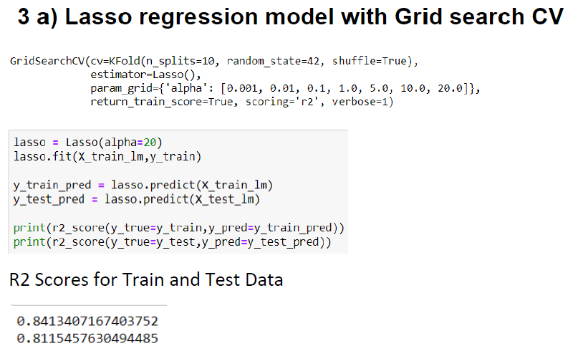
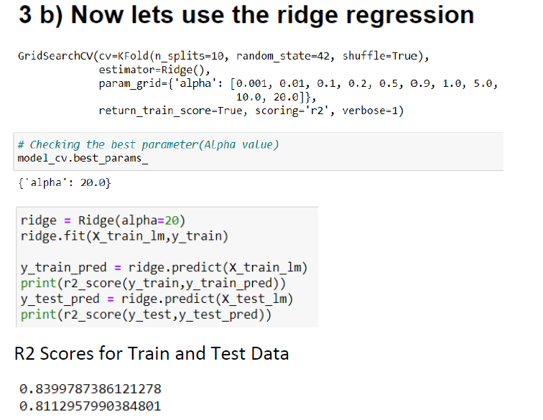
Comparing Lasso and Ridge
Finally, after all the model testing, I’ve found Lasso Ridge to be the best performing model. Building final Model.

Slide 15
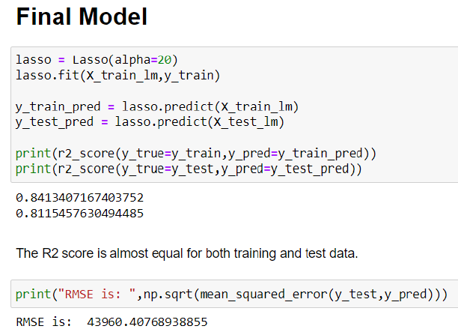
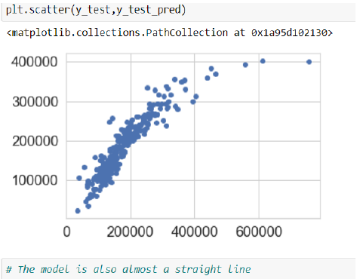
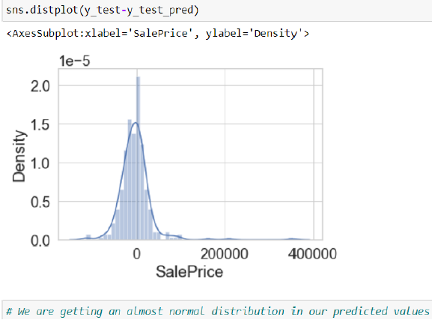

Slide 16
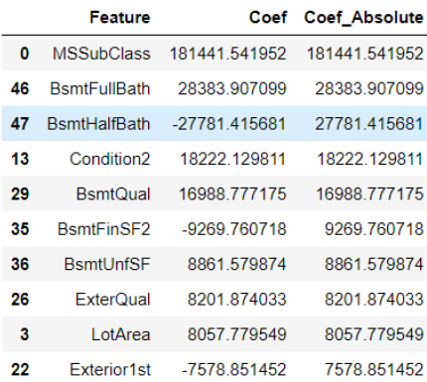
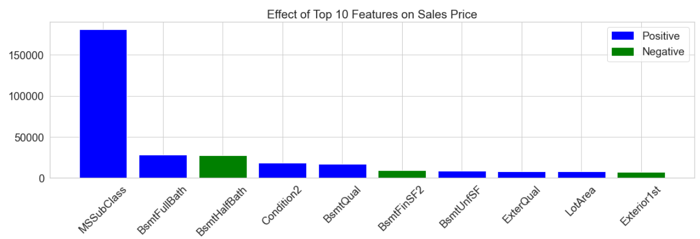
Effect of Top 10 Features Effecting Sales Price

Slide 17
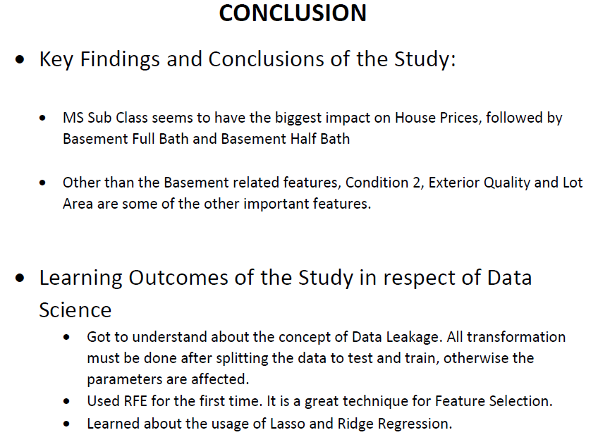

Slide 18
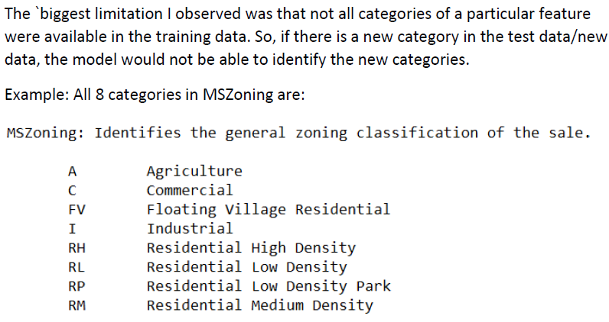
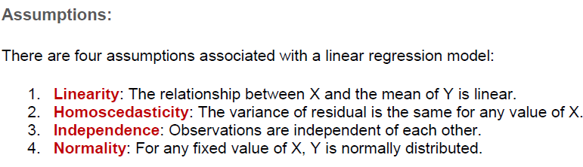
Limitations & Assumptions
For future, data collection should be done in a way that all such categories are included.

